Slide 1
Rapid Testing Approach
September 2009

Slide 2

What is ‘Rapid Testing’?
‘Rapid Testing’ is a test approach which is carried out using no particular recognised test case design technique.
Although an informal method of testing it does not mean “Cowboy”

Slide 3
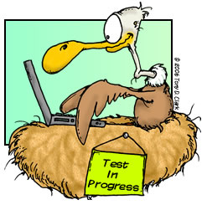
You don’t have to be a tester to do ‘Rapid Testing’
If you can....
  travel on different tracks and conduct use-case scenarios to what has been originally specified.
  be relentless and critical about both your work or others.
  be investigative.
  anticipate a users actions.
If you....
  have a “What If / curious” mindset.
  like to explore different approaches.
Chances are, you already do this.

Slide 4

Why not just leave it to QA? Isn’t that their job?
NO ! There are major benefits to others performing ‘Rapid tests’. For example:
Bugs found in development are cheap to fix (no red tape)
Bugs identified early on may be a symptom of a larger issue that will radically affect the design or implementation
Every bug found prior to QA is a bug that a tester doesn't have to waste time finding and reporting and elongating the process.
Winner of the:
“Not My Job”
Award

Slide 5
‘3’ Quick Steps to Rapid Testing
Positive Testing
  ‘End to End’ the functionality works as designed and intended.
Negative Testing
  ‘End to End’, each step through the test scenario, choosing options that shouldn’t be allowed by validating the software prevents this from happening.
Boundary Testing (Identifying ‘edge-cases’ for testing): Examples...
  Dates (Days, Months and Years)
  Times (Hours, Minutes, Seconds)
  Account Status’s (e.g.)
    Visitor tries to watch online a subscription-only film
    Subscriber chooses to watch a free (ad-funded) film
  Establish the variables and the fixed parameters
Try this: Your testing a date field allowing you to choose dates between
01/01/2008 and 31/12/2010. Which dates would you choose?

Slide 6
Some user-testing tips
Functional
Navigational
Various Characters used (hyphens etc..)
Navigating through direct URLs (Copy/Pasting) and URL manipulation
Accurate URL links passed to the browser
End to End scenarios – Start to finish using both valid and invalid paths
Positive and Negative testing
Security – Review what is visible/accessible on screen at all times
Users may want to return to a single starting point each time (User habits)
Multi-tab switching
Multiple clicks on links which have not had time to load
Clicking a new link prior to a page finishing its loading
Mouse over functionality and hovering text
Minimize and Maximize browser
Multiple Browser formats (Cross Browser testing)
Tip: Keep an eye on that explorer status bar

Slide 7

Need more help or want to know more?
Talk to anyone in QA/Testing about how they approach their work
Ask QA/Testing to help you brainstorm test cases for your code
Refer to the article: http://www.scribd.com/doc/10029234/Rapid Testing-Testing
  This provides further information to Rapid (Ad-hoc) testing in more detail
Fogbugz URL: https://fogbugz.lovefilm.com
Fogbugz screenshots and cases easily generated by installing the fogbugz tool found at the following location: https://fogbugz.lovefilm.com/default.php?pg=pgScreenshotDownload

Slide 8
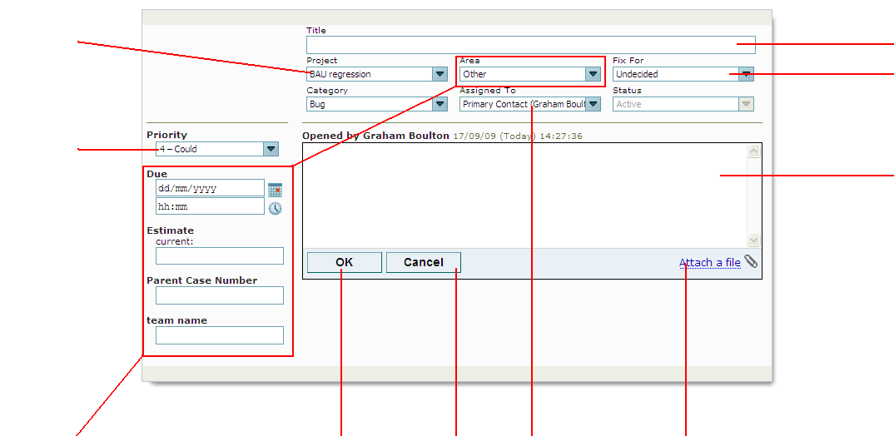
How to raise a bug in Fogbugz
Project: Set to the applicable project created in fogbugz
Title of Bug
Leave as ‘Undecided’ (Unless applicable)
Bug Priority: Use this drop-down to assign the priority required to fix this bug. The four options to choose from are:
Critical
Must
Should
Could
Bug Description: Describe here the bug and the problem. Please be accurate and ensure that you add and provide comments to the following headings:
Description of Problem
  Describe problem in more detail
Expected Result
  Describe what you would expect to see
Steps to Re-Create
  Provide step by step instructions on how to re-create the bug/issue
Browser Version
  State what browser you were using and its version
These fields are not necessary to be completed by the tester and are only used for planning purposes.
OK/Cancel to either submit the bug/case after completion or cancel.
Assign Case: Use this link drop-down to assign the bug to the assigned developer applicable to the defective piece of work
Attach File: Use this link to browse to a captured image on your machine and attach a screenshot of the error to the bug/case

